Slide 1

Vehicle Fuel Consumption Ratings
Team:
Anne Wesley (aewesley@indiana.edu)
Shubham Saurabh (ssaurab@iu.edu)
Varun Joshi (vajoshi@iu.edu)
Notes:
Hello everyone and welcome to our presentation on the "Vehicle Fuel Consumption Ratings" application.
As the world takes baby steps towards electric vehicles,

Slide 2
01
02
Table of Contents
03
04
Our Mission
What does the App do?
Architecture
How does it work?
Core Functionality 1
Fetch emission and ratings for a given vehicle
Core Functionality 2
Compare vehicles based on emission
Notes:
our team wants to contribute by spreading awareness about the environmental impact of gas-powered vehicles.

Slide 3

Our Mission
Only 35% car buyers consider the environmental impact before buying a new vehicle
Make environmental data about new cars available easily
Enable our customers to make wise decisions based not only on the cost and features of their cars, but also taking into account the environmental impact their new car will have
Notes:
It is easy for car buyers to find out and compare cars based on features and prices. But the data about the emissions and environmental impact of a car is seldom advertised. This application will focus on highlighting that same information.
Our main objective is to make environmental data about new cars available easily. We want to enable our customers to make wise decisions based not only on the cost and features of their cars, but also considering the environmental impact their new car will have.

Slide 4
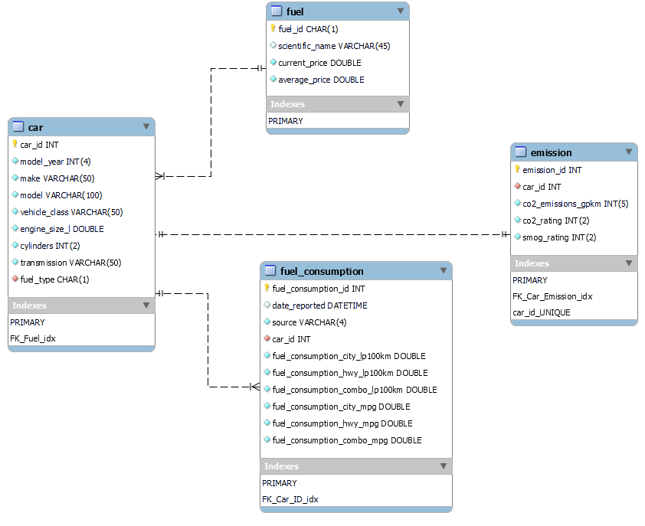
Database Schema
Notes:
We have used the "2022 Fuel Consumption Ratings" dataset from Kaggle to create a database application

Slide 5
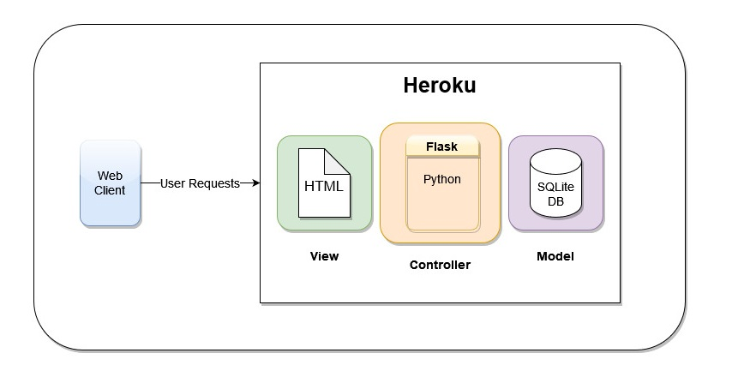
Architecture
Notes:
that will provide information about environmental factors, such as CO2 emissions and ratings, of new vehicles.

Slide 6
Thank you!
Resources
"2022 Fuel Consumption Ratings" dataset from Kaggle
https://www.kaggle.com/datasets/rinichristy/2022-fuel-consumption-ratings/
https://cleantechnica.com/2018/09/10/autolist-study-shows-environmental-concerns-have-little-impact-on-car-buying-decisions/

